Slide 1
Al-Based Internship Recommendation Engine for PM Internship Scheme
CSE7101- Capstone Project
Review-5
Batch Number : ISE_25
Roll Number | Student Name
20221ISE0162 | Sindhu L Y
20221ISE0171 | Anusha M S
20231ISE3001 | Kumar G K
Roll Number S
tudent Name
Under the Supervision of,
Dr. Prajeesh C B
Associate Professor
School of Computer Science and Engineering Presidency University
Name of the Program: Information Science & Engineering
Name of the HoD: Dr. Gopal Krishna​
Name of the Program Project Coordinator: Ms.Suma N G
Name of the School Project Coordinators: Dr. Sampath A K , Dr. Geetha A
20221ISE0156 T
20221ISE0157
hanushree M
Veda S B
20221ISE0039 Sa
ke Sree Joshna

Slide 2
Introduction
This project is developed in response to SIH25034 under the Smart India Hackathon and is aligned with Sustainable Development Goal 4 (SDG 4 – Quality Education). The solution promotes inclusive and equitable access to experiential learning opportunities, enhances skill development, and supports lifelong learning by connecting students to internships that are most relevant to their learning outcomes and professional growth.
By improving the quality of internship allocation and reducing skill mismatches, the proposed system contributes to better learning experiences, higher employability, and a stronger education-to-employment ecosystem in India

Slide 3
Objectives
To build an AI-based internship recommendation system
To analyze resumes and extract relevant skills
To match students with internships using intelligent models
To provide ranked and personalized recommendations
To perform skill gap analysis
To improve employability and reduce mismatch

Slide 4
Analysis of Problem Statement:
Organization: AICTC
Category : Software
Problem Description : The internship allocation process under the PM Internship Scheme is currently inefficient due to manual or rule-based approaches. With a large number of applicants, it becomes difficult to match students accurately with suitable internships. This leads to skill mismatch, lack of personalization, and unequal access to opportunities. The system fails to utilize available data effectively and is not scalable. Therefore, an AI-driven solution is required to provide fair, accurate, and data-driven internship recommendations.

Slide 5
Methodology
User uploads resume through a web application (React + FastAPI)
Resume is cleaned and preprocessed to extract text
Features are extracted using TF-IDF and Sentence-BERT
Text is converted into numerical vectors for processing
AI models (Cosine Similarity, GRU, Hybrid BERT+GRU) analyze the data
Resume is matched with internship dataset and similarity scores are calculated
Internships are ranked based on match scores
Top recommendations and skill gap analysis are shown to the user

Slide 6
Expected Outcomes
Personalized internship recommendations for each user
Ranked list of internships based on match score
Display of internship details (role, company, stipend, location)
Match percentage showing relevance between resume and job
Extracted skills and keywords from the resume
Skill gap analysis highlighting missing skills
Suggestions to improve profile for better opportunities
Fast and accurate recommendation results

Slide 7
Impact
Improves internship selection through personalized recommendations
Reduces skill mismatch between students and industry requirements
Saves time by automating the internship search process
Enhances student employability and career readiness
Ensures fair and unbiased opportunity distribution
Supports large-scale implementation for government schemes
Promotes skill development through gap analysis
Contributes to SDG 4 – Quality Education

Slide 8
Github Link
The Github link provided should have public access permission.
Github Link:https://github.com/910862KUMAR/AI-Internship-Recommendation-System

Slide 9
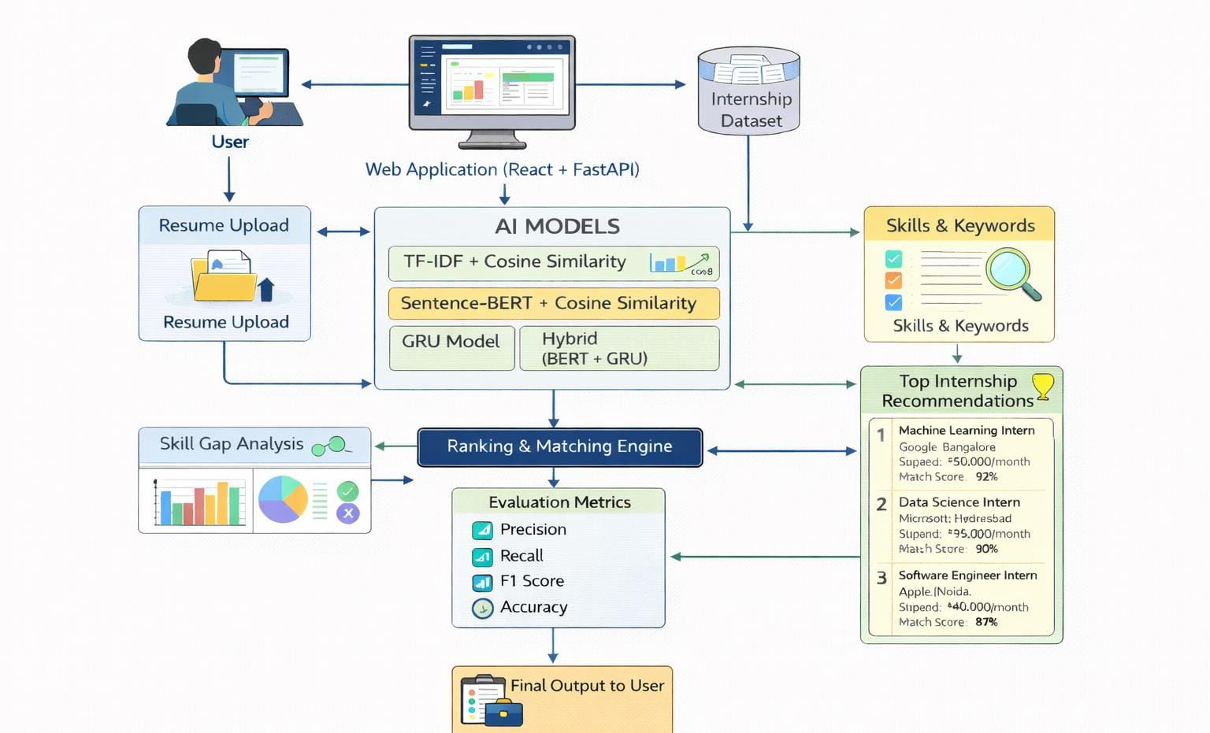
Architecture Diagram:

Slide 10
Timeline of the Project (Gantt Chart)

Slide 11
Conclusion
The AI-Based Internship Recommendation Engine provides an efficient and intelligent solution for internship allocation by using machine learning techniques for accurate skill-based matching. It reduces manual effort, minimizes skill mismatch, and delivers personalized recommendations to students. The system enhances employability, ensures fairness, and supports large-scale implementation. Overall, it demonstrates the effectiveness of AI in improving internship selection and aligns with SDG 4 – Quality Education.

Slide 12
References (IEEE Paper format)
[1] John A. Smith and Rajesh Kumar, "Resume Classification Using Machine Learning Techniques," IEEE Access, vol. 7, no. 1, pp. 14523–14535, Jan. 2019.
[2] Andrew Brown, Li Chen, and Michael Davis, "Natural Language Processing–Based Job Recommendation Systems," Expert Systems with Applications, vol. 145, no. 3, pp. 113104, Mar. 2020.
[3] Liang Wang and Hao Zhao, "Semantic Text Matching Using Bidirectional Encoder Representations from Transformers," in Proceedings of the 58th Annual Meeting of the Association for Computational Linguistics (ACL), pp. 1234–1244, Jul. 2020.
[4] Priya Gupta and Sandeep Mehta, "Automated Resume Screening Using Deep Neural Networks," Springer Lecture Notes in Computer Science, vol. 12654, pp. 210–221, 2021.
[5] Mingyu Chen, Qiang Li, and Robert Thompson, "Transformer-Based Text Embeddings for Intelligent Recommendation," IEEE Transactions on Artificial Intelligence, vol. 2, no. 4, pp. 345–356, Dec. 2021.

Slide 13


